Slide 1
U.S. History
Social Studies
View the Unit in Slide Show mode.

Slide 2
Unit Objectives
After completing this unit, students should be able to:
Identify events and people throughout the Revolutionary and Early Republic period.
Identify key elements of the Civil War and Reconstruction period.
Examine key components of the Civil Rights movement.
Describe the impact of Immigration of Eastern Europeans to the United States.

Slide 3
U.S. History Topics
This lesson is structured in a way to allow the learner to focus on certain events in U.S. History. The following topics and time periods will be reviewed in this lesson.
Revolutionary & Early Republic Period
Civil War & Reconstruction Period
Civil Rights
Immigration of Eastern Europeans

Slide 4
Revolutionary & Early Republic Period
The following slides will review major historical events in the Revolutionary and Early Republic period and their impact on U.S. History.
Students should be able to identify events and people throughout the Revolutionary and Early Republic period.
Revolutionary & Early Republic Period | Revolutionary War
 | George Washington
Civil War & Reconstruction Period | Thomas Jefferson
 | Articles of Confederation
Civil Rights | War of 1812
 | Manifest Destiny
Immigration of Eastern Europeans | U.S. Indian Policy

Slide 5
Revolutionary & Early Republic Period
Click on each of the Key Terms below to display the definition or brief description of the event.
The Revolutionary War was the American War of Indepen-dence. Thirteen colonies declared their independence as the United States of America.
George Washington was the leader Revolutionary War. He was first President of the United States.
Thomas Jefferson was the author of the Declaration of Independence and the third U.S. president.
Revolutionary War
George Washington
Thomas Jefferson
The Articles of Confederation was the first written constitution of the United States. The Articles defined the power of the Congress.
Manifest Destiny expressed the belief that Americans were destined to spread their democracy from coast to coast.
Articles of Confederation
Manifest Destiny

Slide 6
Revolutionary & Early Republic Period
Click each of the categories below to reveal a brief overview of the significant topics relating to American Revolution and Early Republic period.
Early government and policies
Key figures & documents
Significant Events
The Revolutionary War (1775-1783)
The Battle of Saratoga (1777)
Treaty of Paris was signed (1783)
The War of 1812
Manifest Destiny
George Washington
Thomas Jefferson
The Declaration of Independence
The Articles of Confederation
The Continental Congress
Form of central government and authorities
U. S. Indian Policy

Slide 7
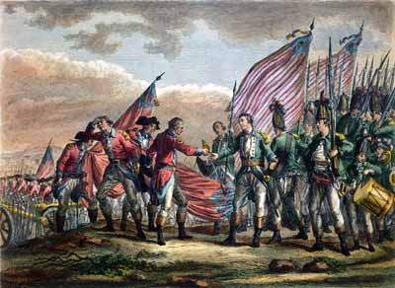
The Revolutionary War
The American Revolutionary War (1775-1783) is also known as the American Revolution and the U.S. War of Independence. Thirteen of the North American colonies of Great Britain declared their independence in 1776 as the United States of America.
The 13 American colonies became increasingly unhappy with British rule. The colonists felt they should have the same rights accorded English citizens. Although there were many factors that led to the Revolutionary War, some important ones were new taxes and regulations, such as:
The Stamp Act (taxed contracts, diplomas, newspapers, deeds, etc.)
The Quartering Act of 1765 (required the American colonists to house, feed, and buy supplies for British troops in the colonies)
The Townshend Acts (five acts 1767 and 1768 that raised new taxes on paper, glass, lead, paint, and tea)
Revolutionary War
View the video: “Social Studies Lesson The Revolutionary War” (2 min and 22 s).

Slide 8
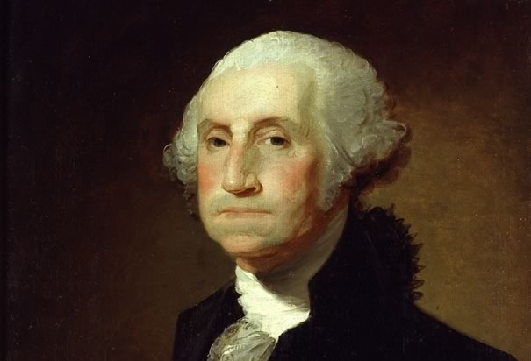
George Washington
George Washington (1732-1799) was the Commander-in-Chief of the Continental Army during the Revolutionary War. He was first President, and one of the founding fathers of the United States.
Washington, who was a wealthy land-owner and a former officer in the British Army, chose to fight for independence from Britain. At the Second Continental Congress in 1775, he was appointed Commander-in-Chief of the Continental Army. Although his men were not as well equipped or experienced as the British soldiers, his military strategies led to two major victories in the Revolutionary War. His men captured British army units at:
George Washington
Saratoga, New York in 1777 (a major turning point of the war)
Yorktown, New York in 1781 (a victory which ended the war)
After the Continental Army defeated the British, Washington presided over the convention that drafted the United States Constitution. Then, he was elected by unanimous vote for two terms as President.

Slide 9
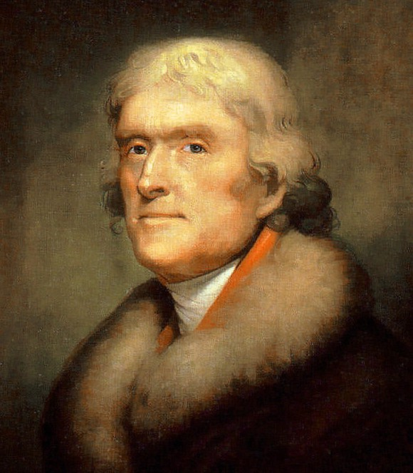
Thomas Jefferson
Thomas Jefferson (1743-1826) was the author of the Declaration of Independence and the third U.S. President. He is a founding father of the United States.
In addition, Jefferson is remembered in history for these significant accomplishments:
Prominent plantation owner and slave-holder from Virginia
Governor of Virginia
Diplomat to France
First Secretary of State
Third President of U.S.
Responsible for Louisiana Purchase in 1803 that doubled size of U.S.
Thomas Jefferson

Slide 10
Check Your Knowledge
What are two specific actions by England that caused conflict with the Colonists and led to the Revolutionary War?
On which day did the Continental Congress vote to adopt the Declaration of Independence?
What was the turning point of the Revolutionary War?
What event indicated the end of the Revolutionary war?
Which of the following statements is correct?
George Washington was the first Secretary of State
George Washington was the author of the Declaration of Independence
Thomas Jefferson was the author of the Declaration of Independence
Thomas Jefferson was the first President of the United States
[Use a pencil/pen and paper to answer the questions; then, click on the arrow to see the correct answers.]
Correct Answers
New taxes, such as on tea and new regulations such as Quartering of Soldiers
July 4, 1776
The Battle of Saratoga
The Treaty of Paris was signed in 1783 indicated the end of the Revolutionary War
C. Thomas Jefferson was the author of the Declaration of Independence

Slide 11
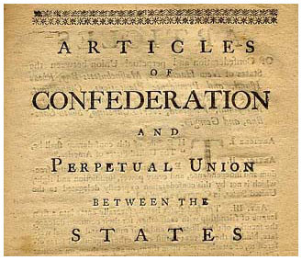
The Articles of Confederation
Ratified on March 1, 1781, the Articles of Confederation was the first written constitution of the United States. Under these articles, the 13 original colonies established the United States of America as a confederation of sovereign and independent states, with Congress serving as the last resort on appeal of disputes. The Congress had the authority to make treaties and alliances, maintain armed forced and coin money.
The Articles established the functions of the national government of the United States after it declared independence. It established a weak central government that mostly, but not entirely, prevented the individual states from conducting their own foreign diplomacy.
On March 4, 1789, the present Constitution of the United States replaced the Articles of Confederation.
The Articles of Confederation

Slide 12
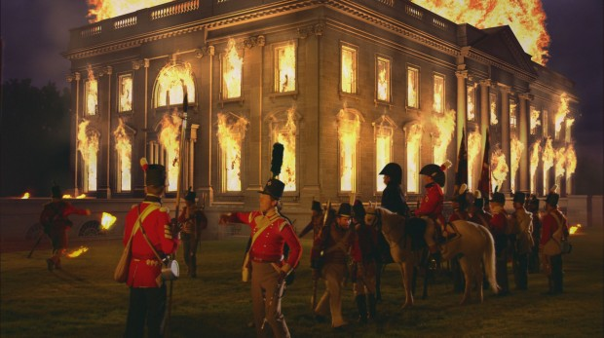
The War of 1812
The United States was a young developing nation when it declared war on Britain in 1812. What caused the War of 1812 between the U.S. and Britain?
Britain imposed trade restrictions on the U.S.
American merchant sailors were forced to serve in the British Royal Navy.
After 2 ½ years, the war ended with the signing of the Treaty of Ghent, and friendly trade resumed between Britain and America.
The Burning of the White House

Slide 13
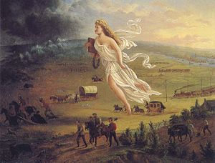
Manifest Destiny
Manifest Destiny was a widely held belief during the 19th century period of American expansion. The term expressed the belief that Americans were destined to spread their democracy from coast to coast.
The Louisiana Purchase (1803) and the acquisition of other territories from Britain, Spain, and Texas in the early to mid-1800s, provided a vast expanse of forests, open land, and rivers all the way to the Pacific Ocean. Although some brave men and women started going West during this time, it was the discovery of gold in California in 1849 that
Manifest Destiny
sparked a major rush of thousands of people West. Probably of greatest significance is that the U.S. government passed the Homestead Act of 1862, which encouraged families to settle the West by giving them land (usually 160 acres) almost free. Usually people traveled in wagon trains to the territories. Settlers had to live on and improve the land they selected for five years to own the land free and clear. During this same period, the Transcontinental Railroad was being built and which brought business people, investors, traders, and tourists into the territories.

Slide 14
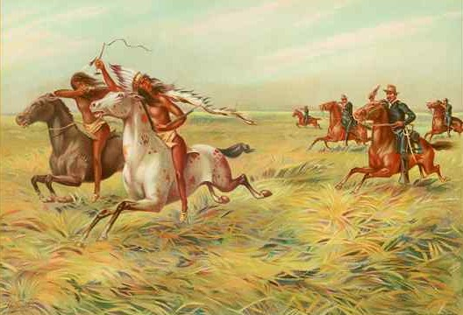
U.S. Indian Policy
Most believe that movement West was part of America’s Manifest Destiny. In 1806, three years after the Louisiana Purchase, the government established a Commissioner of Indian Affairs under the War department to administer Indian affairs. Many people thought that the Indians should be “assimilated.” Therefore, one major focus of the Indian Policy was intended to “Americanize” the Indians and provide them with an education. But, for the most part, land-hungry Americans forced Native Americas to give up their land. Thousands of Indians died due to battles and harsh conditions during displacement to areas that the government set up as “Indian Territory.”
Indian Wars

Slide 15
Check Your Knowledge
1. How does Manifest Destiny relate to the U.S. Indian policies in the 19th Century?
[Use a pencil/pen and paper to answer the questions; then, click on the arrow to see the correct answers.]
Manifest Destiny
Correct Answer
1. Manifest Destiny was widely believed during the 19th Century period of expansion. The Indian Policy intended to “Americanize” the Indians, provide them with education, and force them to give up their land.

Slide 16
Section Review
Revolutionary & Early Republic Period
The Revolutionary War (1775-1783)
The founding fathers: George Washington and Thomas Jefferson
Key historical documents: the Declaration of Independence and the Articles of Confederation
The War of 1812
Manifest Destiny
U.S. Indian Policy
Image References:
Revolutionary War
http://s.hswstatic.com/gif/revolutionary-war-pictures-9.jpg
George Washington
http://www.history.com/photos/george-washington
Thomas Jefferson
http://en.wikipedia.org/wiki/Thomas_Jefferson#/media/File:Thomas_Jefferson_by_Rembrandt_Peale_1805_cropped.jpg
The Articles of Confederation
http://dmshistory8.weebly.com/articles-of-confederation.html
The Burning of the White House
http://bloximages.chicago2.vip.townnews.com/nwitimes.com/content/tncms/assets/v3/editorial/4/b0/4b091f94-9c77-55ea-8639-e80569166d1d/50660ba145a8f.preview-620.jpg
Manifest Destiny
http://en.wikipedia.org/wiki/Manifest_destiny#/media/File:American_progress.JPG
Indian Wars
http://en.wikipedia.org/wiki/American_Indian_Wars#/media/File:Cavalry_and_Indians.JPG

Slide 17
Civil War & Reconstruction Period
The following slides will review the Civil War and Reconstruction period and its impact on U.S. History.
Students should be able identify key elements of the Civil War and Reconstruction period.
Revolutionary & Early Republic Period | Slavery
 | Abolitionist Movement
Civil War & Reconstruction Period | Sectionalism
 | Civil War
Civil Rights | Slaves Freed During the Civil War
 | Reconstruction
Immigration of Eastern Europeans

Slide 18
Civil War & Reconstruction Period
Click on each of the Key Terms below to display the definition or brief description of the event.
Sectionalism – excessive or narrow-minded concern for local or regional interest as opposed to the interest of the whole.
Abolitionist – a person who advocated or supported the abolition of slaver in the U. S.
Sectionalism
Abolitionist
Slavery – bondage or servitude, refers to the involuntary subjection to another or others. Slavery emphasizes the idea of complete ownership and control by a master: to be sold into slavery
Slavery
Civil War – War in the U.S between the Northern and the Southern States.
Constitution – the system of fundamental principles according to which a nation, state, corporation, or the like are governed.
Carpetbaggers – Were Northern whites and African Americans who sought to process from the South’s misfortunes.
Civil War
Constitution
Carpetbaggers

Slide 19
Civil War & Reconstruction Period
Click each of the categories below to reveal a brief overview of the significant topics relating to the Civil War and Reconstruction.
The Civil War
Reconstruction
Key Amendments
Slave trade begins in 1606
First Slaves land in America in 1619.
Lincoln elected in 1860
Civil War begins in 1861
1865 the Civil War ends
Begins in 1865 and ends in 1877
1865 the Freedmen Bureau was established
1865 the Freedmen Savings Bank was established
1866 Civil Rights Bill was passed by Congress
Emancipation Proclamation is signed into law in 1862
Amendment is ratified 1865
Fourteenth Amendment is ratified in 1868
Fifteenth Amendment is ratified in 1870

Slide 20
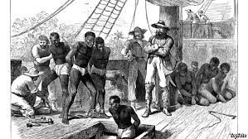
Slavery
The British colonists who fled England in search of a new way of life soon realized the land was vast and harsh. Even though indentured servants were sent to help, it was not enough. Slaves were brought to Jamestown in 1619, starting the practice of slavery. For the next 245 years, slavery was an integral part of the economic system in America.
With the introduction of African slaves, Southern white colonists soon realized this free labor was profitable. Northern white colonists likened slavery to the rule of King George III and felt slaves should be given their freedom.
The first slaves arrived in Jamestown, Virginia in 1619
View the video: “Origins of Slavery in America” (3 min 01 s) and be prepared to answer questions about slavery in America.

Slide 21
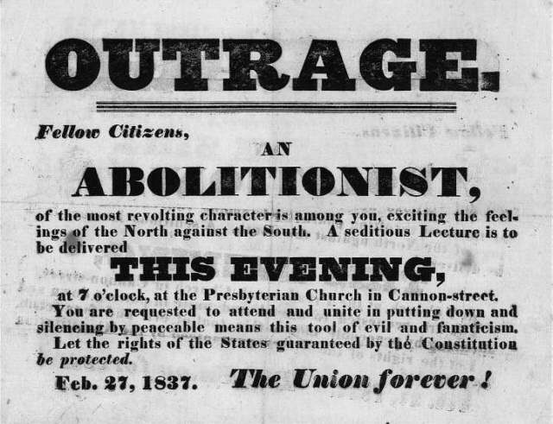
Abolitionist Movement
The goal of the Abolitionist Movement was to end slavery, which many felt was both unconstitutional and immoral. In fact, many Christians, led the cause. Quakers, in particular, banned slavery. Some key names of the Abolitionist Movement were: William Lloyd Garrison (founder of the anti-slavery newspaper, The Liberator), Frederick Douglass (colleague of Garrison and leading anti-slavery spokesperson), and Harriet Tubman (leader of the Underground Railroad). The abolitionist movement fueled tensions leading up to the Civil War.
Abolitionist flyer inviting people to a meeting
View the video: “The Abolitionist Movement” (3 min 26 s) and be prepared to answer questions about the abolitionist movement.

Slide 22
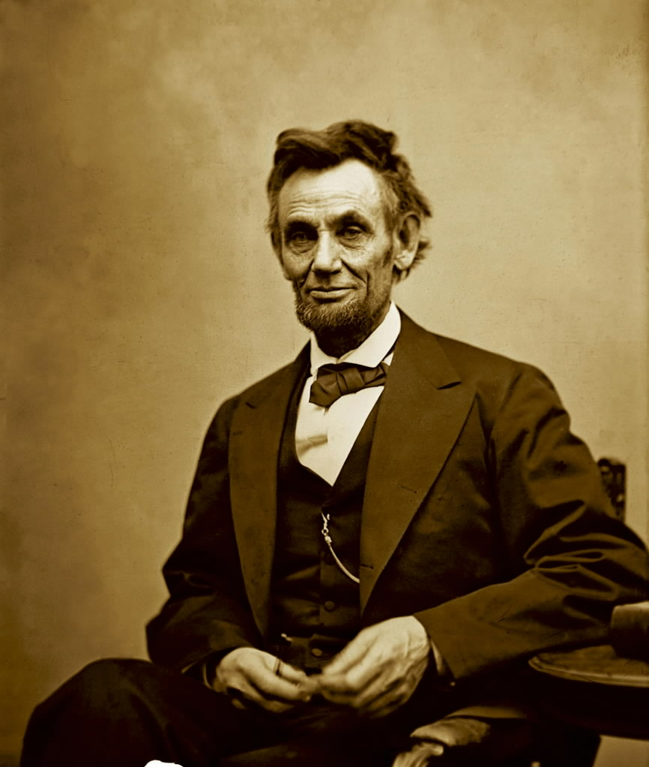
Sectionalism
As Southern Colonies continued to prosper from slaves, a movement in the northern colonies was forming against the institution of slavery. With the election of Abraham Lincoln in March of 1861, the disagreements between the North and the South on whether to abolish slavery caused a rift that would lead to war. This was known as sectionalism.
Southerners did not want to remain in the Union with a president who did not support their position on slavery. Seven states seceded and formed a new country, the Confederate States of America.
Abraham Lincoln, 16th President of the United States 1861-1865
View the video: “The Lincoln Legacy” (3 min 12 s) and be prepared to answer questions about Abraham Lincoln.

Slide 23
Civil War (1861-1865)
The United Stated needed to decide what kind of nation it wanted to be. Would it be a nation of individual states or a nation with one system of government? The Civil War centered around the country’s newly drafted Constitution, which granted equal rights and protections to the slaves. There were those who were firmly against giving equal rights to the slaves and refused to agree to the newly drafted Constitution.
For many years, Southern States were against giving slaves their freedom. During this time, white southern plantation owners became rich off of free slave labor. With the election of Abraham Lincoln, a staunch abolitionist, southern whites feared that their right to own slaves would be taken away. With Lincoln’s election and the secession of South Carolina in 1860, America drew closer to war.
View the video: “The Path to Civil War” (3 min) and be prepared to answer questions about the Civil War.

Slide 24
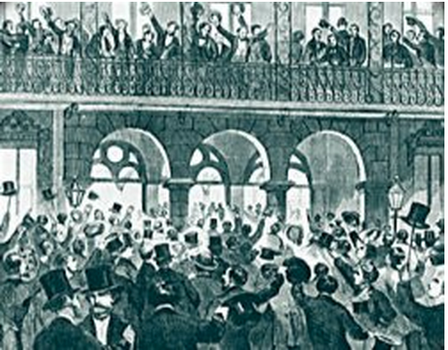
Slaves Freed During the Civil War
The Emancipation Proclamation was an executive order signed by President Abraham Lincoln on January 1, 1863. This document granted slaves living in the South legal status. It was issued by Lincoln as part of his war time powers and was not a legal document passed by the United States Congress. The proclamation did not grant citizenship to freed ex-slaves nor did it compensate slave owners.
Lincoln used the proclamation to weaken the Confederate Army. The proclamation also gave the United States government the ability to draft all freed persons into the Armed Forces. This strategy gave the Southern Union the manpower it needed in its fight against the South. Freed slaves who joined the Union Army were paid for their service.
South Carolinians crowd into the streets of Charleston in 1860 to hear speeches promoting secession
View the video: ”Emancipation Proclamation (1863)” (2 min 12 sec) and be prepared to answer questions about the Emancipation Proclamation.

Slide 25
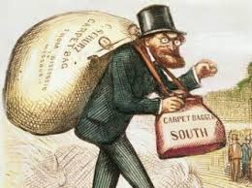
Reconstruction (1865-1877)
The ten years that followed the Civil War was known as the Reconstruction Period. It was a period of rebuilding for both the North and the South. With the North's victory in the war, African Americans were finally given the freedom they had been seeking. The Southern States were readmitted into the Union.
This meant granting slaves the rights given to all other citizens under the Constitution and the Bill of Rights. To protect the rights of freed slaves, the government sent troops to the Southern States to protect them.
Carpetbaggers and Scalawags flooded the south in hopes of prospering from the South’s misfortunes after the Civil War.

Slide 26
Check Your Knowledge
What did you learn about the Civil War?
A major result of the Civil War was that the:
economic system of the South became a dominate force in the United States economy
federal government’s power over the states was strengthened
members of Congress from Southern States gained control of the legislative branch
country’s industrial development came to a grinding halt
Early in his Presidency, Lincoln declared that his primary goal as President was to:
enforce the Emancipation Proclamation
preserve the Union
end slavery throughout the entire country
encourage sectionalism
[Use a pencil/pen and paper to answer the questions; then, click on the arrow to see the correct answers.]
Correct Answers
B. A major result of the Civil War was that the federal government’s power over the states was strengthened.
B. Early in his Presidency, Lincoln declared that his primary goal as President was to preserve the Union.

Slide 27
Check Your Knowledge
Before the Civil War, slavery expanded in the South rather than the North because
The Constitution contained a clause that outlawed the importation of slaves into the Northern States
Congress passed a law forbidding slavery in the North
Northern states passed an affirmative action legislation
Geographic conditions in the South encouraged the development of large plantations
Which argument did President Lincoln use against the secession of the Southern States?
Slavery was not profitable.
The government was a union of people and not states.
The Southern states did not permit their people to vote on secession.
As Commander in Chief, his duty was to defend the United States against foreign invasion.
[Use a pencil/pen and paper to answer the questions; then, click on the arrow to see the correct answers.]
Correct Answers
3. D. Geographic conditions in the South encouraged the development of large plantations.
4. B. The government was a union of people and not states.

Slide 28
Section Review
Civil War & Reconstruction Period
Slavery
Abolitionist Movement
Emancipation Proclamation
Sectionalism
Civil War (1861-1865)
Slaves Freed During the Civil War
Reconstruction (1865-1877)
Image References:
The first slaves arrived in Jamestown, Virginia in 1619
http://parksfacts.blogspot.com/2011/01/slave-trade.html
Abolitionist flyer inviting people to a meeting
http://www.loc.gov/exhibits/african/afam005.html
Abraham Lincoln
http://www.politifact.com/wisconsin/statements/2013/apr/21/paul-ryan/lincoln-backed-slavery-measures-us-rep-paul-ryan-s/
South Carolinians crowd into the streets of Charleston in 1860 to hear speeches promoting secession
http://www.civilwar.org/education/history/civil-war-overview/statesrights.html
Carpetbaggers and Scalawags
http://www.google.com/imgres?imgurl=https://media2.wnyc.org/i/raw/photologue/photos/Carpetbagger.jpg&imgrefurl=http://www.wnyc.org/story/136776-will-travel-district/&h=250&w=201&tbnid=NJkTCvT8yicYSM:&zoom=1&tbnh=160&tbnw=128&usg=__eEauCzA7FUK6XjqfY5Qqd9GA5G8=&docid=eZsUbbXQJQL8JM&itg=1

Slide 29
Civil Rights Movement
The following slides will review the Civil Rights movement and its impact on U.S. History.
Students should be able to examine key components of the Civil Rights movement.
Revolutionary & Early Republic Period | Significant Events of Civil Rights
 | Women’s Suffrage
Civil War & Reconstruction Period
Civil Rights
Immigration of Eastern Europeans

Slide 30
Civil Rights Movement
Click on each of the Key Terms below to display the definition or brief description of the event.
Civil Rights are the rights of citizens to political and social freedom and equality.
The Jim Crow Laws were a series of racial segregation laws (state and local) after the Reconstruction period in Southern United States until 1965.
Women’s Suffrage is the right of women to vote and to stand for electoral office
Civil Rights
Jim Crow Laws
Women’s Suffrage
Plessy vs. Ferguson was a landmark U.S. Supreme Court decision in 1896 upholding the constitutionality of state laws requiring racial segregation in public facilities under the doctrine of "separate but equal.”
Brown vs. Board of Education was a landmark U.S. Supreme Court case in 1954 in which the Court declared state laws establishing separate public schools for black and white students to be unconstitutional.
Plessy vs. Ferguson
Brown vs. Board of Education

Slide 31
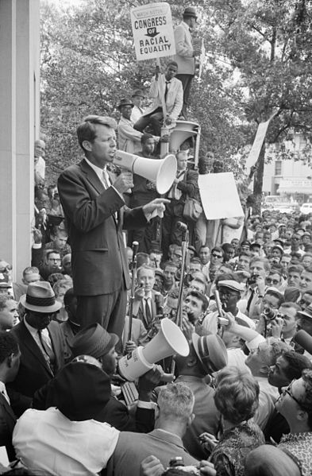
Civil Rights Movement
The Civil Rights Movement was characterized by a series of social movements within the United States with the primary aim of ending racial segregation and discrimination, and gaining equal rights.
Two legislative victories signed into law by President Johnson granted rights to African Americans and women. These laws helped change people’s attitudes as well as business and government practices.
The Civil Rights Act of 1964:
Prohibited discrimination on the basis of sex as well as race in hiring, promoting, and firing
Established the Equal Employment Opportunity Commission (EEOC) to implement the law
The Voting Rights Acts of 1965 struck down the voting practices used in many southern states including literacy tests as a prerequisite to voting.
Robert F. Kennedy speaking to a Civil Rights crowd in front of the Justice Department building in 1963.

Slide 32
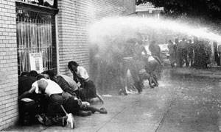
Practice Your Skills
The year 1963 was pivotal in the efforts of civil equality. Martin Luther King’s “I Have a Dream” speech at the March on Washington laid the foundation for a year that sparked the beginning of the end for legal segregation.
Navigate to the website, “1963: The Defining Year of the Civil Rights Movement”
[If the link does not take you to the Website, copy and paste the following URL into your browser: http://www.theguardian.com/world/2013/may/07/1963-defining-year-civil-rights
Open a Word document and address the questions below, in one or two paragraphs. (This might take you 10 to 15 minutes.)
Why was 1963 such a critical year for Civil Rights?
What are some of the key events that changed the trajectory of the Civil Rights movement?
Submit your response to your teacher.
Civil Rights protestors being attacked with a water cannon

Slide 33
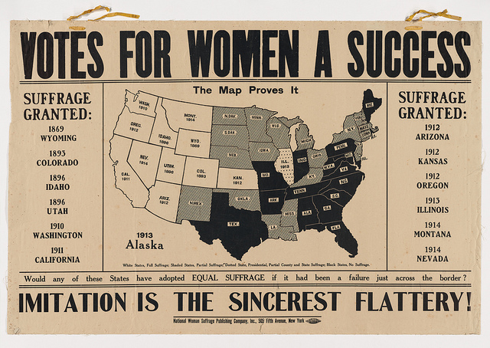
Women’s Suffrage
At the founding of the United States, women were almost entirely excluded from voting. As women began to grow displeased with their status, the movement for women’s suffrage began in the early 1800s, also during the time of the rebellion against slavery.
In the suffrage movement, women not only wanted the right to vote, but also sought other rights they were denied:
The right to own property
Run for office
Have their own money and property if married
Votes for Women a Success

Slide 34
Check Your Knowledge
What did you learn in the previous slide about Women’s Suffrage?
What is Women’s Suffrage?
Women seeking the right to work beside men
Women seeking the right to drive a car
Women seeking the right to attend card games
Women seeking the right to vote
What were some other rights being sought by women during the suffrage movement?
[Use a pencil/pen and paper to answer the questions; then, click on the arrow to see the correct answers.]
Votes for Women a Success
Correct Answers
D. Women seeking the right to vote
Women were also seeking the right to own property, run for office, and to retain their own property and money, among other inequalities

Slide 35
Section Review
Civil Rights Movement
Civil Rights Movement
Civil Rights Act of 1964: Prohibited discrimination on the basis of sex and race.
Voting Rights Act of 1965: Reform of voting practices in southern states, such as literacy tests.
Women’s Suffrage Movement
Efforts beginning in early 1800s and into 1900s of women to gain equality; rights to vote, own property, and hold political office are several.
Image References:
RFK Speaking to Civil Rights Crowd
http://en.wikipedia.org/wiki/African-American_Civil_Rights_Movement_(1954%E2%80%9368)
Civil Rights Protestors
http://i.guim.co.uk/static/w-620/h--/q-95/sys-images/Guardian/About/General/2013/5/6/1367846464418/Civil-rights-protestors-a-010.jpg
Vote for Women a Success!
http://via.lib.harvard.edu/via/deliver/fullRecordDisplay?_collection=via&inoID=925401&recordNumber=65&fullgridwidth=5&method=view&recordViewFormat=grid

Slide 36
Immigration of Eastern Europeans
The following slides will review immigration of Eastern Europeans to America and their impact on U.S. History.
Students should be able to describe the impact of immigration of Eastern Europeans to the United States.
Revolutionary & Early Republic Period | Growth in Immigration
 | Significance of Ellis Island
Civil War & Reconstruction Period | Settling of Immigrants
Civil Rights
Immigration of Eastern Europeans

Slide 37
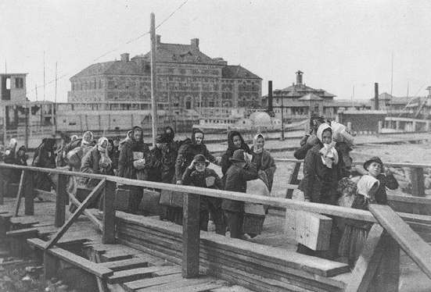
Immigration of Eastern Europeans
After the depression of the 1890s, immigration to American jumped from 3.5 million to a high of 9 million starting in the 1900s.
Immigration from Northern and Western Europe had slowed, and following the 1800s, immigrants poured in from Eastern European Countries, as well as Southern European regions, Canada and Latin America.
By 1910, Eastern and Southern Europeans made up 70 percent of the immigrants entering the United States; most of which were processed through Ellis Island, in New York.
Immigrants arriving at Ellis Island, 1902

Slide 38
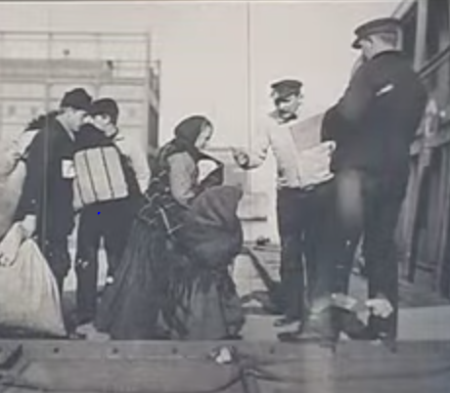
Immigration of Eastern Europeans
Early expansion of immigration has its roots in Ellis Island, New York, the main entry point of over 12 million immigrants from 1892 to 1954.
It is estimated that roughly 40% of Americans can trace an ancestor to the entrance records at Ellis Island.
Ellis Island by VOA News
View the video: “Ellis Island” (2 min 37 s) and be prepared to answer questions about Ellis Island.

Slide 39
Check Your Knowledge
What did you learn from the video Ellis Island?
Each day, how many immigrants are estimated to have arrived at Ellis Island?
Thousands
Hundreds
Very Few
Millions
Before Ellis Island, what kind of controls existed over immigration?
When and why did the U.S. implement a screening system at Ellis Island?
[Use a pencil/pen and paper to answer the questions; then, click on the arrow to see the correct answers.]
Ellis Island by VOA News
Correct Answers
A. It is estimated that thousands of immigrants arrived at Ellis Island each day.
Before Ellis Island, there were no controls over immigration to the U.S.
In 1921, controls were tightened and a screening system was implemented to curb the large influx of immigrants from Eastern Europe.

Slide 40
Immigration of Eastern Europeans
Reasons Eastern European immigrants made the journey to America differed little from those of their predecessors.
To escape religious, racial, and political persecution
To seek relief from economic depression and famine
Drawn by contract labor agreements, popular with Italian and Greek laborers
Hungarians, Poles, Slovaks, Bohemians, and Italians flocked to the coal mines or steel mills
Greeks preferred textile mills, Russian and Polish Jews worked the needle trades or pushcart markets of New York
Railroad companies advertised the availability of free or cheap farmland overseas in pamphlets distributed in many languages, bringing a handful of agricultural workers to western farmlands.
Overall, the vast majority of immigrants crowded into the growing cities, hoping for a chance to make a better life for themselves.

Slide 41
Section Review
Immigration of Eastern Europeans
Increase in Immigration of Eastern Europeans
Decrease in Northern and Southern European after depression in 1890
Over 12 million immigrants from Eastern Europe 1892-1954
Came through Ellis Island, New York
Ellis Island
1st federally controlled immigration system in United States
Settling of Immigrants
Arrived seeking a better life, freedom, and opportunity
Settled in big cities
Image References:
Immigrants Arriving at Ellis Island, 1902
http://en.wikipedia.org/wiki/Immigration_to_the_United_States#/media/File:Ellis_island_1902.jpg

Slide 42
Course Review
Revolutionary & Early Republic Period
The Revolutionary War (1775-1783)
The War of 1812
Manifest Destiny
U.S. Indian Policy
Civil War & Reconstruction Period
Slavery
Abolitionist Movement
Emancipation Proclamation
Sectionalism
Civil War (1861-1865)
Slaves Freed During the Civil War
Reconstruction (1865-1877)
Civil Rights
Civil Rights Movement
Women’s Suffrage Movement
Immigration of Eastern Europeans
Increase in Immigration of Eastern Europeans
Ellis Island
Settling of Immigrants

Slide 43
For Further Exploration
Revolutionary & Early Republic Period
George Washington https://www.youtube.com/watch?v=hvE9fb--Dig
Thomas Jefferson https://www.youtube.com/watch?v=uAt1YLP3T34
Manifest Destiny https://www.youtube.com/watch?v=YLmUhT9QOlE
The War of 1812 http://www.ussconstitutionmuseum.org/about-us/bicentennial/short-history-1812/
U.S. Indian Policy http://americanindiantah.com/history/nar_19thcenturyrelations.html
American Revolution History
http://www.history.com/topics/american-revolution/american-revolution-history
1800s - Federal Indian Policy developes
http://www.savagesandscoundrels.org/flashpoints-conflicts/1800s-federal-indian-policy-developes/
Manifest Destiny http://www.ushistory.org/us/29.asp

Slide 44
For Further Exploration
Civil War & Reconstruction Period
The Civil War’s Greatest Myths http://www.history.com/topics/black-history/slavery/videos/lincoln-the-legacy
Last Stand of the Confederacy
http://www.history.com/topics/black-history/abolitionist-movement/videos/the-confederacys-last-stand?m=528e394da93ae&s=undefined&f=1&free=false
Timeline of Slavery http://www.ushistory.org/more/timeline.htm
The Impact of Slavery http://www.ushistory.org/us/12a.asp
The New African-American Culture http://www.ushistory.org/us/6g.asp
Abolitionist Movement http://www.history.com/topics/black-history/abolitionist-movement
Westward http://www.let.rug.nl/usa/outlines/history-1994/westward-expansion-and-regional-differences/westward.php
North and South: Different Cultures, Same Country http://www.civilwar.org/education/history/civil-war-overview/northandsouth.html
Sectionalism http://www.socialstudieshelp.com/Lesson_29_Notes_SEC_HO.htm
Why Non-Slaveholding Southerners Fought http://www.civilwar.org/education/history/civil-war-overview/why-non-slaveholding.html
The Cost of the War http://www.civilwar.org/education/civil-war-casualties.html
A New African-American Culture http://www.ushistory.org/us/6g.asp
Emancipation Proclamation (1863) http://www.ourdocuments.gov/doc.php?flash=true&doc=34

Slide 45
For Further Exploration
Civil Rights
The Fight for Women’s Suffrage
http://www.history.com/topics/womens-history/the-fight-for-womens-suffrage
Women Who Fought for the Vote
http://www.history.com/topics/womens-history/women-who-fought-for-the-vote
In Pursuit of Equality - Separate is Not Equal
http://americanhistory.si.edu/brown/history/2-battleground/pursuit-equality-1.html
Civil Rights Movement
http://www.history.com/topics/black-history/civil-rights-movement

Slide 46
For Further Exploration
Immigration of Eastern Europeans
Immigration Timeline
http://www.libertyellisfoundation.org/immigration-timeline
Ellis Island
http://www.history.com/topics/ellis-island
Ellis Island History
http://www.libertyellisfoundation.org/ellis-island-history
European Immigration and Defining Whiteness
http://www.understandingrace.org/history/gov/eastern_southern_immigration.html

